Slide 1

INC300
Week 6
Privacy By Design
Amanda Piche, PhD Candidate
June 28th, 2018

Slide 2
Today’s Agenda
Check-in
Lecture: Privacy By Design
  Topics: Canadian Federal Privacy laws and What They Cover; Privacy By Design
Test #1

Slide 3
Lecture 6: Privacy By Design
Learning Outcomes:
Understand the federal privacy law that governs citizens’ data privacy (PIPEDA)
Understand the framework of Privacy By Design and its’ role in encouraging privacy is taken into account throughout the whole engineering process
Acquire additional strategies to protect our privacy and personal information

Slide 4




Week 5 Recap
How the structure of social networking sites has lead to the inability to compartmentalize elements of our social lives, otherwise known as “context collapse”.
Defined the role of copyright in protecting creator’s rights and for copyright exemptions to give users’ certain permissions to use copyrighted material
Explored the potential for remix culture to encourage the creation of innovative works.
Examined how the terms of service on social networking sites define copyright and what can be done with whatever you upload to your account.

Slide 5

Hook: Facebook & Cambridge Analytica
Notes:
Link featured in photo: https://www.youtube.com/watch?v=mrnXv-g4yKU
What do you think the consequences of this event might be for Facebook and Cambridge Analytica? Do you think this had an effect on Facebook users at all?

Slide 6
Questions:
Do we really care about privacy?
Is there such a thing as a right to privacy?
Should “privacy” be considered as important to defend as rights like safety or freedom of expression? Why?
Notes:
Yes! Privacy is not specifically named as a right in the Charter of Rights, but the federal government and some provinces and territories have established privacy commissioners to advocate for Canadians’ privacy rights and to investigate complaints under Canada’s two privacy laws, the Privacy Act and the Personal Information Protection and Electronic Documents Act, as well as equivalent laws in Alberta, British Columbia, New Brunswick, Newfoundland and Labrador, Ontario and Quebec, which give you specific rights to privacy when dealing with governments and private businesses respectively. The Supreme Court of Canada has stated that the privacy laws have “quasi-constitutional status”, and that the values and rights set out in the Act are closely linked to those set out in the Constitution as being necessary to a free and democratic society.

Slide 7
Protecting Your Privacy
Ask questions: Get in the habit of reading privacy policies associated with the websites and apps you use.
Only download apps from official and trusted app stores.
Privacy settings: Mobile devices, browsers, sites/apps and other web-enabled items often have adjustable privacy settings. For devices, this may include the ability to control everything from location tracking to screen locks. For browsers, users can often control things like cookies and pop-ups, while apps and websites such as social media sites generally allow users to control what personal information others can see about them. Be sure to review and adjust privacy settings regularly and never rely on default settings.
App permissions: During installation, verify that the permissions being sought by the app match not only what the privacy policy says but also what you would expect the app to require. (Permissions within mobile apps allow the app access to your device’s data and capabilities in order to run. These permissions could include location, identity, email and contacts.) Also pay attention to the app description in the app store as well as any “in-app” notices which may explain the app’s collection and use of personal information.
Private browsing: Some browsers have a “private browsing mode,” but super and Flash cookies are not always covered by these settings.
Do Not Track: Some browsers allow you to send a message to websites asking them not to track your activities while you’re using them. This is usually found in the “Privacy” section of the “Settings” menu (sometimes you have to click on “Advanced Settings”.)
Don’t give out more information than you have to: Avoid sharing too many personal details with large numbers of people, for example by allowing open access to your social media pages. Familiarize yourself with the privacy settings of your favourite social networks and adjust them according to your comfort level. When posting information online it’s also worth thinking about who might see it apart from your intended audience—would the things you write or the pictures you post cause embarrassment in real life? How would you feel if your current or potential employer saw what you posted?
Turn off GPS when you don’t need it: Many apps collect your GPS information, and it’s also automatically included in photos you take with your phone. You can avoid this by turning off GPS when you’re not using it. You can also go into your device’s settings and turn off Geotagging, which means photos (but not other apps) don’t have your GPS information.
Make sure you erase any apps (and all other personal information) from your device before you donate, resell or recycle it.
Notes:
Personal information is information about an identifiable individual. It can include your name, birthday, email address, and phone number. It can also include your opinions, your spending habits, your IP address, photos and digital images, and your email and text messages.

Slide 8
Canadian Federal Privacy laws and What They Cover
Canada has two federal privacy laws that are enforced by the Office of the Privacy Commissioner of Canada:
  the Privacy Act, which covers how the federal government handles personal information;
  the Personal Information Protection and Electronic Documents Act (PIPEDA), which covers how businesses handle personal information.

Slide 9
The Privacy Act
The Privacy Act relates to a person’s right to access and correct personal information that the Government of Canada holds about them. The Act also applies to the Government’s collection, use and disclosure of personal information in the course of providing services such as:
  old age security pensions
  employment insurance
  border security
  federal policing and public safety
  tax collection and refunds.
The Privacy Act only applies to federal government institutions listed in the Privacy Act Schedule of Institutions. It applies to all of the personal information that the federal government collects, uses, and discloses. This includes personal information about federal employees.
The Privacy Act offers protections for personal information, which it defines as any recorded information “about an identifiable individual.”

Slide 10
The Personal Information Protection and Electronic Documents Act (PIPEDA)
PIPEDA sets the ground rules for how private-sector organizations collect, use, and disclose personal information in the course of for-profit, commercial activities across Canada. It also applies to the personal information of employees of federally-regulated businesses such as:
  banks
  airlines
  telecommunications companies.
What does PIPEDA apply to?
  PIPEDA generally applies to personal information held by private sector organizations that are not federally-regulated, and conduct business in Manitoba, New Brunswick, Newfoundland and Labrador, Northwest Territories, Nova Scotia, Nunavut, Ontario, Prince Edward Island, Saskatchewan, Yukon.
Federally-regulated organizations that conduct business in Canada are always subject to PIPEDA and must also apply the act to their employees’ personal information.
Under PIPEDA, personal information means information about an identifiable individual.

Slide 11
What does PIPEDA not apply to?
PIPEDA does not apply to organizations that do not engage in commercial, for-profit activities.
Unless they are engaging in commercial activities that are not central to their mandate and involve personal information, PIPEDA does not generally apply to:
  not-for-profit and charity groups
  political parties and associations.
Municipalities, universities, schools, and hospitals are generally covered by provincial laws. PIPEDA may only apply in certain situations. For example, if the organization is engaged in a commercial activity which is outside of its core activity such as, a university selling an alumni list.

Slide 12
What does PIPEDA not apply to?
Each province and territory in Canada has a commissioner or ombudsperson responsible for overseeing provincial and territorial privacy legislation.
The Information and Privacy Commissioner of Ontario is responsible for overseeing and enforcing the following provincial access and privacy laws:
  Freedom of Information and Protection of Privacy Act, Ontario’s provincial public sector privacy law;
  Municipal Freedom of Information and Protection of Privacy Act, Ontario’s municipal public sector privacy law;
  Personal Health Information Protection Act, 2004, Ontario’s privacy law relating to health records that has been that has been deemed “substantially similar” to the federal private sector privacy law with respect to health information custodians.

Slide 13
PIPEDA & Behavioural/Targeted Advertising
“Online behavioural advertising may be considered a reasonable purpose under the Personal Information Protection and Electronic Documents Act (PIPEDA), provided it is carried out under certain parameters, and is not made a condition of service for accessing and using the Internet, generally.”
“PIPEDA requires an individual’s knowledge and consent for the collection, use, or disclosure of personal information. PIPEDA also requires that the purposes for which an individual’s information is to be collected, used or disclosed be explained in a clear and transparent manner. In addition, PIPEDA does recognize that the form of consent can vary: for example, express consent (opt-in) when dealing with sensitive information, and implied consent (opt-out) when the information is less sensitive. It is important to note that the sensitivity of information depends on the nature of the information and the context in which it is being collected, used or disclosed.”
“Any collection or use of an individual’s web browsing activity must be done with that person’s knowledge and consent. Therefore, if an individual is not able to decline the tracking and targeting using an opt-out mechanism because there is no viable possibility for them to exert control over the technology used, or if doing so renders a service unusable, then organizations should not be employing that type of technology for online behavioural advertising purposes. At present, this could include, for example, so-called zombie cookies, super cookies and device fingerprinting.’”
Notes:
Source: https://www.priv.gc.ca/en/privacy-topics/advertising-and-marketing/behaviouraltargeted-advertising/gl_ba_1112/
Some forms of tracking can be blocked or prevented while other methods cannot. If users cannot block or otherwise prevent a given method from being used for OBA, the industry should not engage its use for OBA purposes at this time

Slide 14
Privacy Protection Principles: Your Right to Privacy
The Personal Information Protection and Electronic Documents Act (PIPEDA) and the Model Code for the Protection of Personal Information set out 10 principles of fair information practices, which set up the basic privacy obligations of private businesses under the law. These principles are your privacy rights when it comes to what organizations can do with your personal information, and each organization’s Privacy Policy and Terms of Service should show how they respect them.
Governments are covered by a different set of privacy rules: the federal government and its agencies are covered under the Privacy Act, the provincial and territorial governments and their agencies are subject to their own protection of privacy acts. The laws that apply to governments are based upon the same principles as PIPEDA, but one major difference is that governments do not generally require your consent to collect your personal information.
Notes:
In March 1996, the Canadian Standards Association (CSA) published the Model Code for the Protection of Personal Information. Canada was the first country in the world to establish a voluntary, national standard for personal information protection.
The Model Code was largely based on the Guidelines Governing the Protection of Privacy and Transborder Flows of Personal Data, created by the Organization for Economic Cooperation and Development (OECD). While the Code remains a voluntary standard, it enjoys strong support and endorsement by a variety of Canadian companies as the national standard on privacy protection.
In April 2000, the Personal Information Protection and Electronic Documents Act (PIPEDA) became law. The CSA Model Code forms an important component of the PIPEDA.

Slide 15
Fair Information Principles
Accountability - organizations should take good care of your personal information and it should be easy to find out what their privacy policy is and who you can talk to if you have a question or a problem
Identifying purposes – organizations should clearly tell you why they’re collecting any piece of personal information, either before they collect it or when they collect it
Consent – organizations should make sure you understand what they’re going to do with your information and make sure you’ve agreed to it before they collect it
Limiting Collection – organizations should only collect what they actually need, and only collect it in ways that are fair and legal
Limiting use, disclosure and retention - they should only use or share your personal information for the reason they said they were collecting it, and not keep it longer than they need to
Accuracy - they should make sure that any information they have about you is correct and up-to-date
Safeguards - they should take steps to keep your personal information from being hacked or stolen
Openness - you should be able to easily find and understand what they do with your personal information and what you can do if you have a problem
Individual Access - you should be able to find out everything they’ve collected about you
Challenging compliance - it should be easy to make a complaint if you think they haven’t respected your privacy rights, and they should tell you what they can do to make things right
Notes:
https://www.priv.gc.ca/en/privacy-topics/privacy-laws-in-canada/the-personal-information-protection-and-electronic-documents-act-pipeda/p_principle/
These principles are your privacy rights when it comes to what organizations can do with your personal information, and each organization’s Privacy Policy and Terms of Service should show how they respect them

Slide 16

Activity
Find out how well CraveTV respects the rights laid out in the Fair Information Principles by searching the services Terms of Service and Privacy Policy: https://support.bell.ca/Billing-and-Accounts/Security_and_privacy/How_does_Bell_respect_my_privacy

Slide 17
Privacy By Design
With the shift from industrial manufacturing to knowledge creation and service delivery, the value of information and the need to manage it responsibly have grown dramatically. At the same time, rapid innovation, global competition and increasing system complexity present profound challenges for informational privacy.
While we would like to enjoy the benefits of innovation − new conveniences and efficiencies − we must also preserve our freedom of choice and personal control over our data flows. Always a social norm, privacy has nonetheless evolved over the years, beyond being viewed solely as a legal compliance requirement, to also being recognized as a market imperative and critical enabler of trust and freedoms in our present-day information society.
There is a growing understanding that innovation, creativity and competitiveness must be approached from a “design-thinking” perspective − namely, a way of viewing the world and overcoming constraints that is at once holistic, interdisciplinary, integrative, innovative, and inspiring.
Privacy, too, must be approached from the same design-thinking perspective. Privacy must be incorporated into networked data systems and technologies, by default. Privacy must become integral to organizational priorities, project objectives, design processes, and planning operations. Privacy must be embedded into every standard, protocol and process that touches our lives.
Source: The 7 Foundational Principles - Implementation and Mapping of Fair Information Practice
Notes:
Source: www.ontla.on.ca/library/repository/mon/24005/301946.pdf

Slide 18
7 Foundational Principles of Privacy By Design
Proactive not Reactive; Preventative not Remedial - Privacy by Design comes before-the-fact, not after
Privacy as the Default - no action is required on the part of the individual to protect their privacy − it is built into the system, by default
Privacy Embedded into Design - privacy is integral to the system, without diminishing functionality.
Full Functionality – Positive-Sum, not Zero-Sum – PbD avoids the pretence of false dichotomies, such as privacy vs. security, demonstrating that it is possible, and far more desirable, to have both
End-to-End Lifecycle Protection – PbD ensures cradle to grave, lifecycle management of information, end-to-end
Visibility and Transparency: Keep it Open - component parts and operations remain visible and transparent, to both users and providers alike
Respect for User Privacy: Keep it User-Centric - requires architects and operators to keep the interests of the individual uppermost by offering such measures as strong privacy defaults, appropriate notice, and empowering user-friendly options

Slide 19

General Data Protection Regulation
Notes:
New rules for how companies can treat user data.
https://www.youtube.com/watch?v=j6wwBqfSk-o

Slide 20
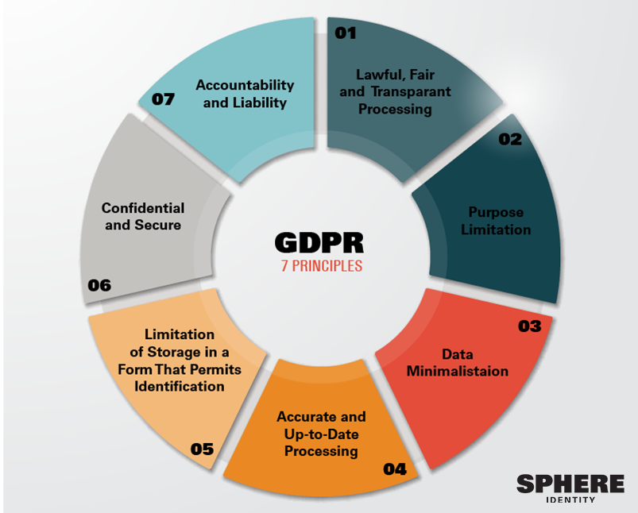
GDPR & Privacy By Design
The GDPR changes European privacy rules. One monumental change is the introduction of the Privacy by Design and Privacy by Default Framework.
The GDPR requires organizations to consider privacy at the earliest stage. Privacy must be one of the ingredients of a new product or service, rather than a sauce that is added at the end.
Article 25 of the GDPR covers privacy by design, or the concept of creating and building systems with data protection principles woven into the framework.
Data Protection By Design (aka privacy by design)
  Article 25 requires organizations to implement appropriate controls to ensure data protection (meaning security and privacy) is a core component the lifecycle of their products, services, procedures, and technical solutions.
Data Protection By Default (aka privacy by default)
  The other part of Article 25 requires that only the necessary amount of data for the purpose of processing is processed. This also has implications for the amount of data that is collected, the extent to which the data is processed, the length of time it is stored, and its accessibility. The key here is that the collected and processed data is not accessible to others without the consent of the data subject.

Slide 21
Lecture 6: Privacy By Design
In this lesson, we have:
Discussed the federal privacy law that governs citizens’ data privacy (PIPEDA) and, as an example, explored to what degree Bell Canada abides by it
Explored the framework of Privacy By Design and its’ role encouraging privacy is taken into account throughout the whole engineering process
Acquired additional strategies to protect our privacy and personal information

Slide 22
For next week:
Next week’s class (July 5th) will be in-class!
Note! Social Media Strategy Document due July 12th (two weeks!)
  Must be submitted on Blackboard

